Slide 1




















A 2-days National Level Hackathon on
AI in education
Smart Education
Team: Hive Minds
Purvesh Kolpe
05 sept 2025
Lohegaon, Pune
www.samadhan.sistec.ac.in/

Slide 2







AREA OVERVIEW
Competitive exam preparation (e.g., GATE) is a high-stakes journey for students aged 16+. Current apps fail to personalize learning, manage stress, or provide holistic guidance. Mentora is designed as an AI-powered Smart Exam Mentor that integrates adaptive learning, mental wellness, and career readiness, aligned with NEP 2020, UGC, and MHRD goals.
IMPORTANCE OF AREA
Exams like GATE decide future careers → high stress and burnout.
Traditional prep tools are generic and ineffective.
AI can make preparation personalized, inclusive, and stress-free.
Ensures both academic excellence and emotional resilience.
Directly supports India’s vision for technology-driven holistic education.

Slide 3


Potential Challenges and Opportunities
Chanllenges
Overloaded syllabus and poor time management.
Exam anxiety and lack of stress management.
Limited access to adaptive tools in regional languages.
Opportunities:
Personalized AI-driven roadmaps and real-time mentoring.
AI-based stress and focus tracking.
Gamification and peer learning to boost engagement.
Scalable platform for all competitive exams, not just GATE.

Slide 4
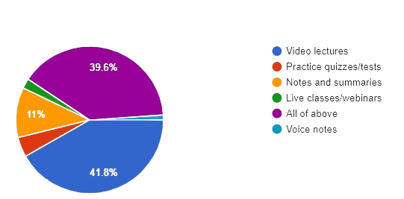
Preliminary Solution Concept
Mentora: A holistic AI Exam Mentor.
Blends personalized learning + stress/wellness tracking + career guidance.
Real-time AI support through voice/chat assistants.
NEP-aligned multilingual inclusivity → reaches all students.
Moves beyond an ‘’exam app” → creates a digital education ecosystem.

Slide 5
Key Features and Functionalities
AI Study Planner (auto-adjusts schedule)
2. Doubt Solver & Voice Assistant
3.Performance Analytics & Weakness Mapping
4. Stress & Wellness Tracker
5. Adaptive Mock Test Generator
6. Peer-to-Peer AI-Matched Study Circles
7. Gamification & Motivation Engine
8. Smart Summarizer & Flashcards
9. Internship & Career Recommender
10. Focus & Productivity Mode
11.Accessibility Features (TTS, high-contrast, regional languages)
12. NEP-Aligned Multilingual Support
13. Mentor & Parent Dashboard
14. AI Exam Strategy Advisor

Slide 6
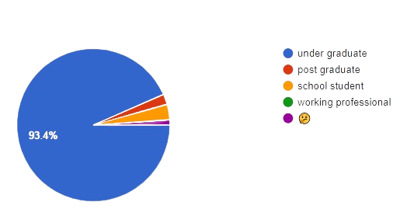
Target Users and Expected Use Cases
Target Users:
Students (16+, GATE aspirants, other competitive exams)
Mentors, parents, institutions
Use Cases:
Student receives a dynamic AI-generated timetable
Instant doubt resolution via chatbot/voice
Wellness tracker detects stress → suggests meditation/breaks
Adaptive mock tests improve exam strategy
Mentors/parents track progress via dashboards

Slide 7
Data Requirements and Privacy Considerations
Data Needed: Study hours, test scores, stress levels, screen time, interaction logs.
Collection: From self-inputs, usage patterns, and AI monitoring.
Privacy Measures:
End-to-end encryption
GDPR & data-compliance
Minimal sharing with mentors (progress only, no personal details)

Slide 8
AI Technologies and Methods
NLP & Voice AI → doubt solving, summarization
Machine Learning → adaptive planner, mock test difficulty scaling
Data Analytics → performance dashboards, weakness mapping
Sentiment & Behavior AI → stress/wellness detection
Gamification AI Engine → engagement & motivation

Slide 9
Implementation Approach
AI Smart Exam Mentor – Web Application
Phase 1: Prototype – study planner, doubt solver, basic analytics.
Phase 2: Stress tracker, gamification, mock test generator.
Phase 3: Career recommender, inclusivity features, mentor dashboard.
Tools: Python, TensorFlow, Flask/Django, React, Firebase, cloud APIs.

Slide 10
Evaluation Metrics
Student performance improvement (accuracy, speed, completion rates).
Reduction in exam stress (wellness scores, self-check-ins).
Engagement (active users, study streaks, test attempts).
Adoption by institutions & scalability.

